Slide 1

Victoria Lee
Business Law II
(BMGT 381)
12/6/2024
Project 2:
Bankruptcy
Notes:
Hello everyone and thank you for coming into my presentation. I am Victoria, and I will assist you in explaining the Bankruptcy Laws based on the given scenario and assets list so that PI can make informed decisions. And so, I have a plan report for these solutions. It is in the next slides.
Name: Victoria Lee
Class and Number: Business Law II (BMGT 381)
Date: 12/6/2024
Project 2: Bankruptcy

Slide 2
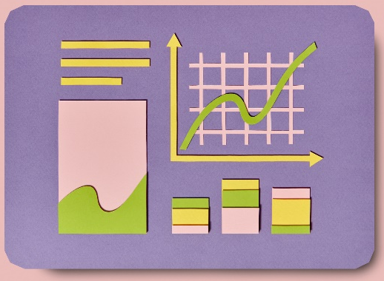
Background Information
And Introduction
PI’s business has been negatively impacted by economic factors like inflation and rising interest rates.
This has led to reduced new contracts, increased costs, and difficulties in collecting payments from customers.
PI’s financial situation is deteriorating, with a loss in the first quarter and a bleak forecast for the next.
Economic slowdown due to inflation and rising interest rates.
Reduced consumer spending and increased defaults on credit.
Negative impact on PI: reduced contracts, higher paint costs, and customer defaults.
First quarter loss and poor forecast for next quarter.
Accountants’ audit requested for a complete financial review.
Figure 1: This represents PI’s business.
Notes:
Before we break down the solutions to help Painted Images (PI), we must go over the background information before the analysis.
So far Painted Images (PI), a five-year-old business, is facing significant financial challenges due to a deteriorating economic climate. Rising inflation, interest rates, and reduced consumer spending have led to a decrease in new contracts, increased material costs, and difficulties in collecting payments. These factors have severely impacted PI's financial health, resulting in losses and a bleak short-term outlook. To address this crisis, this analysis should provide a comprehensive financial audit and guidance on potential solutions, such as bankruptcy or restructuring.
This summary will explore the key aspects so that PI can make informed decisions to minimize potential risks.
(Advanced Business Law and the Legal Environment, 2014; UMGC, n.d.).

Slide 3

Audit Summary – Assets List
Cash in Bank: $10,987.56
Reserve (CD): $100,000.00
Real Property: $200,000.00
Warehouse: $250,000.00
Inventory: $12,000.00
Fixtures: $35,682.00
Office Furnishings: $15,500.00
Tools and Equipment: $2,500.00
Accounts Receivable: $55,235.75
Figure 2: This represents the Assets List
Notes:
So far PI has a list of assets which is useful for determining the bankruptcy laws and other recommendations for this case. This includes a List of Assets such as:
Cash in Bank: $10,987.56
Reserve (CD): $100,000.00
Real Property: $200,000.00
Warehouse: $250,000.00
Inventory: $12,000.00
Fixtures: $35,682.00
Office Furnishings: $15,500.00
Tools and Equipment: $2,500.00
Accounts Receivable: $55,235.75
(Advanced Business Law and the Legal Environment, 2014; UMGC, n.d.).

Slide 4
Audit Summary – Liabilities List
According to Advanced Business Law and the Legal Environment (2014), the list of liabilities is below:
Mortgage on Property (First State Bank): $105,000.00
Construction Loan (First State Bank): $175,000.00
Secured Loan on Fixtures (PNC Bank): $22,970.00
Inventory Secured on Floating Lien (First State Bank): $12,000.00
Secured Loan by Office Furnishings (PNC Bank): $10,500.00
Unsecured Line of Credit (First State Bank): $150,000.00
Unsecured Loans Made by Owners: $150,000.00
Payroll and Taxes: $12,350.00
Rent on Office/Showroom: $3,000.00
Insurance: $5,000.00
Office Supplies (Office Depot): $350.00
Tools and Equipment (Lowe’s): $675.00
Notes:
According to Advanced Business Law and the Legal Environment (2014) and UMGC(n.d.), the list of liabilities is below:
PI's liabilities include a $105,000 mortgage, a $175,000 construction loan, and various secured loans totaling $45,470 on fixtures, inventory, and office furnishings. Additionally, PI owes $150,000 on an unsecured line of credit, $150,000 in unsecured loans from owners, and approximately $22,375 for payroll, taxes, rent, insurance, office supplies, and equipment.
(Advanced Business Law and the Legal Environment, 2014; UMGC, n.d.).

Slide 5
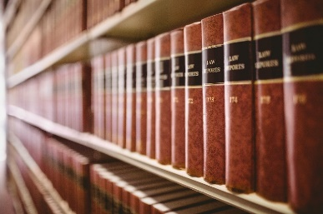
Bankruptcy Option 1: Chapter 7
According to Advanced Business Law and the Legal Environment (2014),
Requirements:
Available to individuals, partnerships, and corporations.
Must pass the means test if an individual.
Involves liquidation of non-exempt assets.
Filing Steps:
File a petition with the bankruptcy court.
Submit schedules of assets, liabilities, income, and expenditures.
Attend a meeting of creditors.
Liquidation and distribution of non-exempt assets by the trustee.
Discharge of remaining unsecured debts.
Figure 3: This represents the list of laws
Notes:
According to Advanced Business Law and the Legal Environment (2014) and UMGC (n.d.),
Chapter 7 bankruptcy, available to individuals, partnerships, and corporations, involves liquidating non-exempt assets to pay off creditors. After filing a petition, individuals must pass a means test to qualify. The process includes submitting financial schedules, attending a creditor meeting, and cooperating with a trustee who liquidates assets and distributes proceeds to creditors. Once the liquidation process is complete, remaining unsecured debts are typically discharged.
Chapter 7 bankruptcy can provide a fresh start for PI by allowing them to liquidate assets and discharge debts. This process can relieve the financial burden and enable the company to focus on rebuilding its business. However, it's important to consider the long-term implications, such as damage to credit rating and potential loss of assets. Given PI's assets, including $10,987.56 in cash, $100,000 in a CD, $200,000 in real property, $250,000 in warehouse value, $12,000 in inventory, $35,682 in fixtures, $15,500 in office furnishings, $2,500 in tools and equipment, and $55,235.75 in accounts receivable, Chapter 7 could potentially lead to the liquidation of these assets to satisfy creditor claims.
(Advanced Business Law and the Legal Environment, 2014; UMGC, n.d.).

Slide 6

Bankruptcy 2: Chapter 11
According to Advanced Business Law and the Legal Environment (2014) and UMGC (n.d.),
Requirements:
Typically used by businesses.
Allows for reorganization rather than liquidation.
Business must have substantial income and assets.
Filing Steps:
File a petition with the bankruptcy court.
Submit a detailed reorganization plan.
Obtain approval from creditors and the court.
Restructure debts and continue operations under the plan.
File regular reports and adhere to the approved plan.
Figure 4: This represents the law
Notes:
According to Advanced Business Law and the Legal Environment (2014) and UMGC (n.d.),
Chapter 11 bankruptcy is a complex process primarily used by businesses to reorganize their debts rather than liquidate assets. To qualify, a business must have substantial income and assets. The process involves filing a petition, submitting a detailed reorganization plan, and obtaining approval from creditors and the court. Once approved, the business restructures its debts and continues operations under the court-approved plan. Regular reports must be filed to ensure compliance with the plan. Given PI's assets, including $10,987.56 in cash, $100,000 in a CD, $200,000 in real property, $250,000 in warehouse value, $12,000 in inventory, $35,682 in fixtures, $15,500 in office furnishings, $2,500 in tools and equipment, and $55,235.75 in accounts receivable, Chapter 11 could be a suitable option for PI. It would allow the company to reorganize its debts, potentially reduce its debt burden, and continue operating its business.
(Advanced Business Law and the Legal Environment, 2014; UMGC, n.d.).

Slide 7
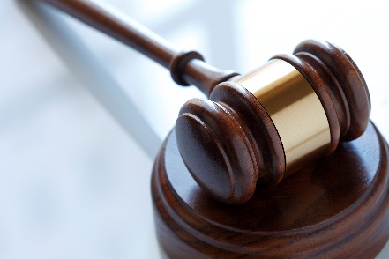
Other Options: Debt Restructuring
According to Advanced Business Law and the Legal Environment (2014) and UMGC (n.d.),
Debt Restructuring helps negotiate new terms with creditors to reduce payments, and interest rates, or extend repayment periods.
This is beneficial for PI as it avoids bankruptcy, maintains business operations, and potentially improves cash flow.
For instance, PI is struggling to meet its monthly debt payments due to decreased revenue and increased costs. Then PI approaches their primary lender, First State Bank, to discuss potential solutions. Through negotiations, they agree to restructure the terms of the loan. The bank agrees to lower the interest rate, extend the repayment period, and reduce the monthly payment amount. This restructuring allows PI to maintain its operations, improve cash flow, and avoid the costly and time-consuming process of bankruptcy (Advanced Business Law and the Legal Environment, 2014; UMGC, n.d.).
Figure 5: This represents the law
Notes:
According to Advanced Business Law and the Legal Environment (2014, Chapters 20, 25, and 26 and Legal Information Institute (n.d.), Debt restructuring involves negotiating new terms with creditors to reduce payments, and interest rates, or extend repayment periods. This can be good for PI as it allows them to avoid bankruptcy, maintain business operations, and improve cash flow. For example, PI could negotiate with their primary lender, First State Bank, to restructure their loan terms. This might involve lowering the interest rate, extending the repayment period, or reducing the monthly payment amount. Additionally, Debt restructuring offers a significant advantage over bankruptcy by allowing PI to maintain control over its operations and avoid the legal complexities and potential negative publicity associated with bankruptcy proceedings. With assets like $10,987.56 in cash, $100,000 in a CD, $200,000 in real property, $250,000 in warehouse value, $12,000 in inventory, $35,682 in fixtures, $15,500 in office furnishings, $2,500 in tools and equipment, and $55,235.75 in accounts receivable, PI may be able to leverage these assets as collateral or negotiate favorable terms with creditors. By restructuring their debt, PI can alleviate financial pressure and improve their long-term financial stability (Advanced Business Law and the Legal Environment, 2014; UMGC, n.d.)

Slide 8
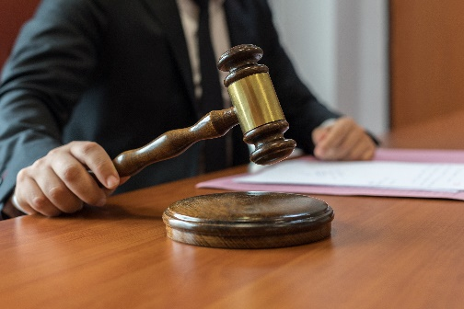
Other Option: Asset Sales
According to Advanced Business Law and the Legal Environment (2014) and UMGC (n.d.),
An Asset Sale is when PI sells non-essential assets to raise cash and pay down debts.
This is beneficial for PI as it reduces liabilities without filing for bankruptcy, provides immediate cash flow, and can stabilize the financial condition.
For instance, based on the given assets provided, PI could consider selling non-essential assets such as excess inventory, unused equipment, or even a portion of its real estate holdings. This case would apply if PI sells its excess inventory worth $12,000 or the unused tools and equipment valued at $2,500. By selling these assets, PI can generate immediate cash, reduce its debt burden, and improve its overall financial position. However, it's important to weigh the short-term benefits of asset sales against reduced operational capacity (Advanced Business Law and the Legal Environment, 2014; UMGC, n.d.).
Figure 6: This represents the law
Notes:
According to Advanced Business Law and the Legal Environment (2014) and UMGC (n.d.),
PI can improve its financial position by selling non-essential assets like excess inventory or unused equipment. For instance, selling $12,000 worth of excess inventory or $2,500 worth of unused tools and equipment could generate immediate cash, reducing debt and improving cash flow. However, it's crucial to consider the potential impact on its operations which may be affected. This is an alternative method because Selling non-essential assets allows PI to improve its financial position without legal proceedings and requirements which makes it simpler and avoids bankruptcy cons. Therefore, by selling assets as the other option, PI can generate immediate cash, reduce debt, and improve its cash flow, potentially allowing the business to continue operating (Advanced Business Law and the Legal Environment, 2014; UMGC, n.d.).

Slide 9
Other Option: Cost Reduction
According to Advanced Business Law and the Legal Environment (2014) and UMGC (n.d.), cost reduction is another alternative method because it implements lowered costs such as reducing staff, negotiating contracts, or cutting expenses that are not needed.
This method is beneficial for PI as it improves profitability, reduces financial strain, and preserves business operations.
For instance, PI can reduce unnecessary stock and associated storage costs such as reducing the inventory value from $12,000 to a more optimal level could free up valuable funds. Additionally, reducing labor costs or renegotiating supplier contracts can reduce overall expenses. This means that, if possible, PI should also consolidate a smaller facility to reduce rent and utility costs. This would be the case if PI has multiple locations, then consolidating into a single place could save costs, and as well as purchasing only the items needed for continuing operations can keep the financial situation stable (Advanced Business Law and the Legal Environment, 2014; UMGC, n.d.).
Figure 7: This represents the law
Notes:
According to Advanced Business Law and the Legal Environment (2014) and UMGC (n.d.),
This third alternative option other than bankruptcy would be Cost reduction. This allows PI to improve profitability and reduce financial strain. By implementing measures like reducing inventory, negotiating contracts, and consolidating operations, PI can free up funds for other tasks while maintaining financial stability. For example, reducing excess inventory from $12,000 to a more optimal level, renegotiating supplier contracts, or consolidating multiple locations into a single facility can significantly reduce costs and improve the company's financial health. Therefore, this would be the third alternative option (Advanced Business Law and the Legal Environment, 2014, Chapters 20, 25, and 26; Legal Information Institute, n.d.).

Slide 10
Recommendation:
According to Advanced Business Law and the Legal Environment (2014) and UMGC (n.d.),
Recommended Action:
The Best Recommended Option for PI’s Case and Assets is Chapter 11 Bankruptcy.
Why:
Option with Chapter 11 Bankruptcy is the best out of all the options because it allows PI to reorganize debts and continue PI’s business tasks. This helps keep a structured plan to address financial issues while mitigating the issues of Chapter 7’s requirements.
Chapter 7 bankruptcy involves liquidating non-exempt assets to pay off creditors, suitable for individuals with limited assets.
Chapter 11 bankruptcy, on the other hand, allows businesses to reorganize debts and continue operations.
For PI, Chapter 11 would be more appropriate as it allows for debt restructuring and continued business operations. The process involves filing a petition, submitting schedules, and attending a creditor meeting. PI can then propose a reorganization plan to pay creditors over time, potentially reducing debt and emerging from bankruptcy as a viable entity.
This approach avoids asset liquidation, which would occur under Chapter 7.
The other alternative methods are also viable, but the given assets, it demonstrate that Chapter 11 may be the best option.
(Advanced Business Law and the Legal Environment, 2014, Chapters 20, 25, and 26; Legal Information Institute, n.d.).
Notes:
With the slides so far, according to Advanced Business Law and the Legal Environment (2014) and UMGC (n.d.), Chapter 11 bankruptcy is the recommended option for PI. This approach allows PI to reorganize debts and continue operations, avoiding asset liquidation as in Chapter 7. By filing a petition, submitting schedules, and proposing a reorganization plan, PI can potentially reduce debt and emerge from bankruptcy as a viable business. While other alternatives like debt restructuring, asset sales, and cost reduction are viable, Chapter 11 provides a structured framework for addressing financial issues and risks (Advanced Business Law and the Legal Environment, 2014, Chapters 20, 25, and 26; Legal Information Institute, n.d.).

Slide 11

Conclusion or Summary
PI faces significant financial challenges due to economic conditions.
Two primary bankruptcy options analyzed: Chapter 7 (liquidation) and Chapter 11 (reorganization).
Alternative remedies include debt restructuring, asset sales, and cost reduction.
Recommended action is Chapter 11 bankruptcy to reorganize debts and continue business operations.
Figure 8: This represents the conclusion
Notes:
In conclusion, PI is facing significant financial challenges due to economic factors such as inflation and rising interest rates. To address these challenges, Chapter 7 bankruptcy involves liquidating non-exempt assets, while Chapter 11 allows for debt restructuring and continued operations. Alternative strategies include debt restructuring, asset sales (e.g., selling excess inventory or unused equipment), and cost reduction (e.g., reducing inventory, negotiating contracts, consolidating operations). Given PI's financial situation and the need to preserve the business, Chapter 11 bankruptcy is the recommended course of action. This approach allows PI to reorganize its debts, continue operations, and potentially emerge from bankruptcy as a viable entity. Therefore, the best recommendation for this case is Chapter 11.

Slide 12
References & Thank you
Advanced Business Law and the Legal Environment: Chapter 19. (2014). Washington, D.C.: The Saylor Foundation. https://saylordotorg.github.io/text_law-for-entrepreneurs/s22-insurance.html
Advanced Business Law and the Legal Environment: Chapter 18. (2014). Washington, D.C.: The Saylor
Foundation. https://leocontent.umgc.edu/content/dam/equella-content/lgst340/Chapter%2018%20-%20Consumer%20Credit%20Transactions.pdf?ou=1254835
Advanced Business Law and the Legal Environment: Chapter 19. (2014). Washington, D.C.: The Saylor
Foundation. https://leocontent.umgc.edu/content/dam/equella-content/lgst340/Chapter%2019%20-%20Secured%20Transactions%20and%20Suretyship.pdf?ou=1254835
Advanced Business Law and the Legal Environment: Chapter 20. (2014). Washington, D.C.: The Saylor
Foundation. https://leocontent.umgc.edu/content/dam/equella-content/lgst340/Chapter%2020%20-%20Mortgages%20and%20nonconsensual%20Liens%20%282%29.pdf?ou=1254835
Advanced Business Law and the Legal Environment: Chapter 21. (2014). Washington, D.C.: The Saylor
Foundation. https://leocontent.umgc.edu/content/dam/equella-qcontent/lgst340/Chapter%2021%20-%20Bankruptcy.pdf?ou=1254835
Microsoft. (n.d.). Microsoft PPT Stock Images[Stock image]. Microsoft Windows.
UMGC. (n.d.). BMGT 381 Week 7: Chapters 7 and 13. University of Maryland Global
Campus. https://www.youtube.com/watch?v=ZDjl2hahc9o
UMGC. (n.d.). BMGT 381 Week 7: Chapter 11. University of Maryland Global Campus.
https://www.youtube.com/watch?v=hNMaTJs1TMU
UMGC. (n.d.). BMGT 381 Week 7 from the instructor’s perspective. University of Maryland Global
Campus. https://www.cali.org/lesson/16813
Notes:
Thank you for allowing me to present!
I have provided a linear summary and solutions for these cases while considering the risks.
These are all the resources below that I utilized in this PowerPoint summary.
Thank you.

